Slide 1
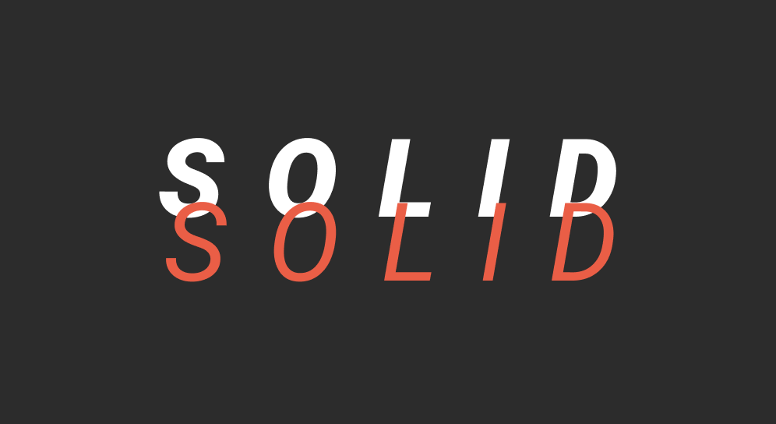
Single Responsibility Principle
Open for Extension Closed for Modification
Liskov Substitution Principle
Interface Segregation Principle
Dependency Inversion

Slide 2

Single Responsibility Principle (SRP)
There should never be more than one reason for a class to change.

Slide 3
SRP (Cont’d)
class User
{
void CreatePost(Database db, string postMessage)
{
try
{
db.Add(postMessage);
}
catch (Exception ex)
{
db.LogError("An error occured: ", ex.ToString());
File.WriteAllText("\LocalErrors.txt", ex.ToString());
}
}
}
Notes:
https://itnext.io/solid-principles-explanation-and-examples-715b975dcad4

Slide 4
SRP (Cont’d)
class User
{
private ErrorLogger errorLogger = new ErrorLogger();
void CreatePost(Database db, string postMessage)
{
try
{
db.Add(postMessage);
}
catch (Exception ex)
{
errorLogger.Log(ex.ToString());
}
}
}
class ErrorLogger
{
void Log(Database db, string error)
{
db.LogError("An error occured: ", error);
File.WriteAllText("\LocalErrors.txt", error);
}
}
Notes:
https://itnext.io/solid-principles-explanation-and-examples-715b975dcad4

Slide 5

SRP (Cont’d)
Which sample code is better to work with?

Slide 6
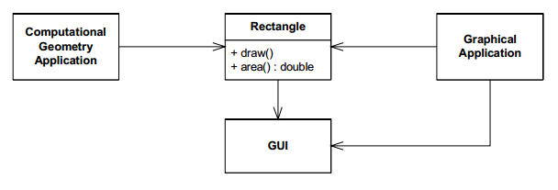
SRP (Cont’d)
Notes:
https://web.archive.org/web/20150906155800/http://www.objectmentor.com/resources/articles/Principles_and_Patterns.pdf

Slide 7
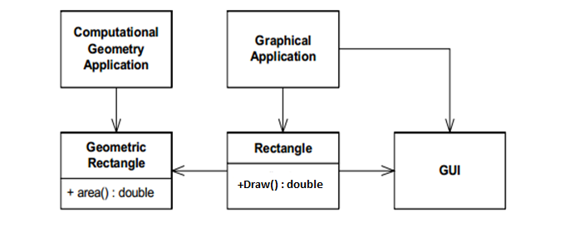
SRP (Cont’d)
Notes:
https://web.archive.org/web/20150906155800/http://www.objectmentor.com/resources/articles/Principles_and_Patterns.pdf

Slide 8
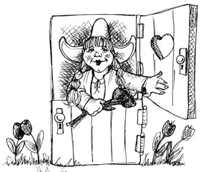
Open Closed Principle (OCP)
A module should be open for extension but closed for modification
Notes:
https://web.archive.org/web/20150906155800/http://www.objectmentor.com/resources/articles/Principles_and_Patterns.pdf

Slide 9

Which one is better?

Slide 10
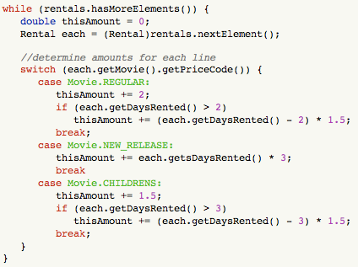
OCP (Cont’d)

Slide 11
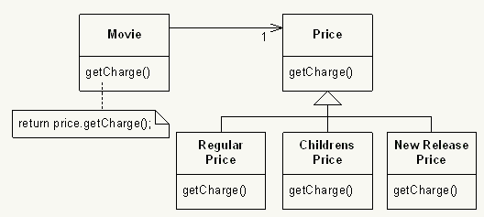
OCP (Cont’d)

Slide 12
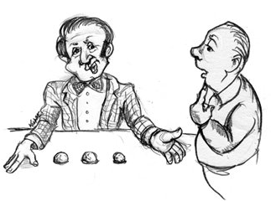
Liskov Substitution Principle (LSP)
Subclasses should be substitutable for their base classes
Notes:
https://web.archive.org/web/20150906155800/http://www.objectmentor.com/resources/articles/Principles_and_Patterns.pdf

Slide 13
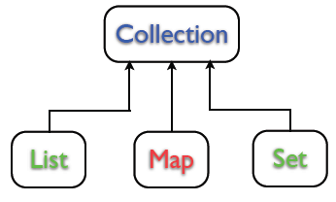
LSP (Cont’d)

Slide 14
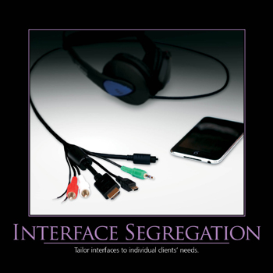
Interface Segregation Principle (ISP)
Many client specific interfaces are better than one general purpose interface

Slide 15
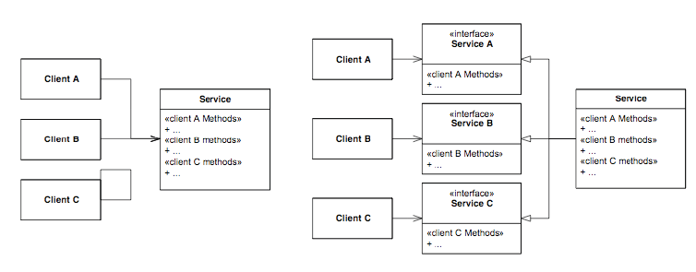
ISP (Cont’d)

Slide 16
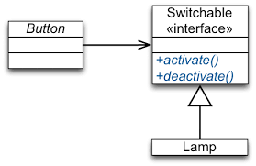
Dependency Inversion Principle (DIP)
Depend upon Abstractions. Do not depend upon concretions.

Slide 17
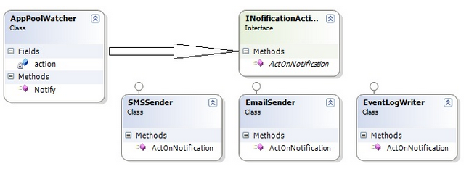
DIP (Cont’d)
Notes:
Source: https://www.codeproject.com/Articles/615139/An-Absolute-Beginners-Tutorial-on-Dependency-Inver

Slide 18
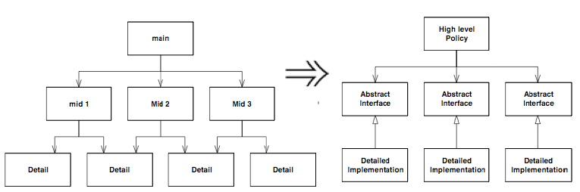
DIP (Cont’d)

Slide 19
The Law of Demeter
Any method of an object should only call methods belonging to:
itself
any composite objects
any parameters that were passed in to the method
any objects it created

Slide 20
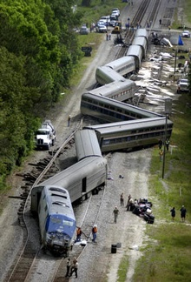
Train Wreck?
Methods belonging to objects that were returned from some other call.
my_television.front_panel.switches.power.on();
v/s
my_television.power_up();
Talk only to your neighbors, not with their neighbors.

Slide 21
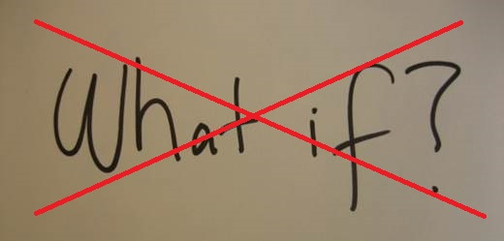
YAGNI (You ain’t gonna need it)
"Always implement things when you actually need them, never when you just foresee that you need them.” – Ron Jeffries
The need for combining it with the supporting practices, rather than using it standalone

Slide 22
Prefer Composition over Inheritance

Slide 23
Keep Your Method Short

Slide 24
Keep Your Method Short

Slide 25
When a program has nothing surprising to say, it should say nothing

Slide 26
Prototype before polishing. Get it working before you optimize it

Slide 27
Design for visibility to make inspection and debugging easier

Slide 28
When you must fail, fail noisily

Slide 29
Keep It Simple & Stupid

Slide 30
“Any intelligent fool can make things bigger, more complex, and more violent. It takes a touch of genius—and a lot of courage to move in the opposite direction” - E. F. Schumacher

Slide 31


